Slide 1
Rusnac EShop
Individual Project
Cristin Rusnac
3616908

Slide 2
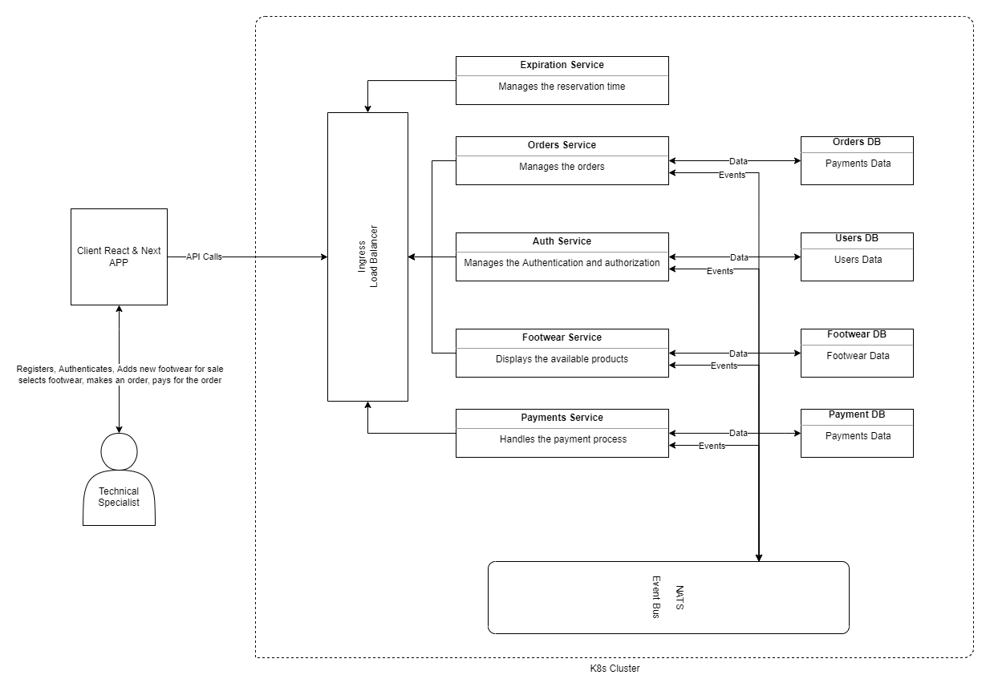
System Architecture

Slide 3
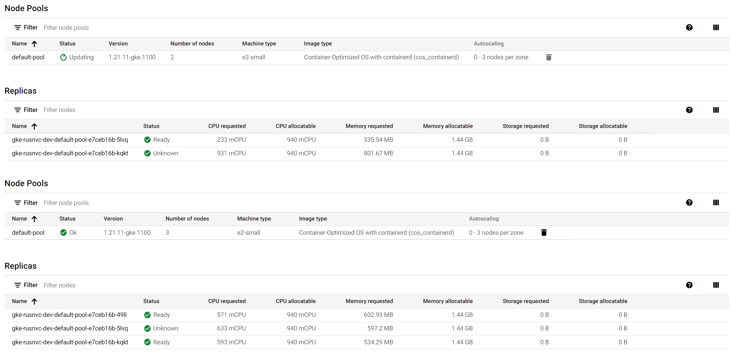
Scalability & Performance: Region Nodes

Slide 4
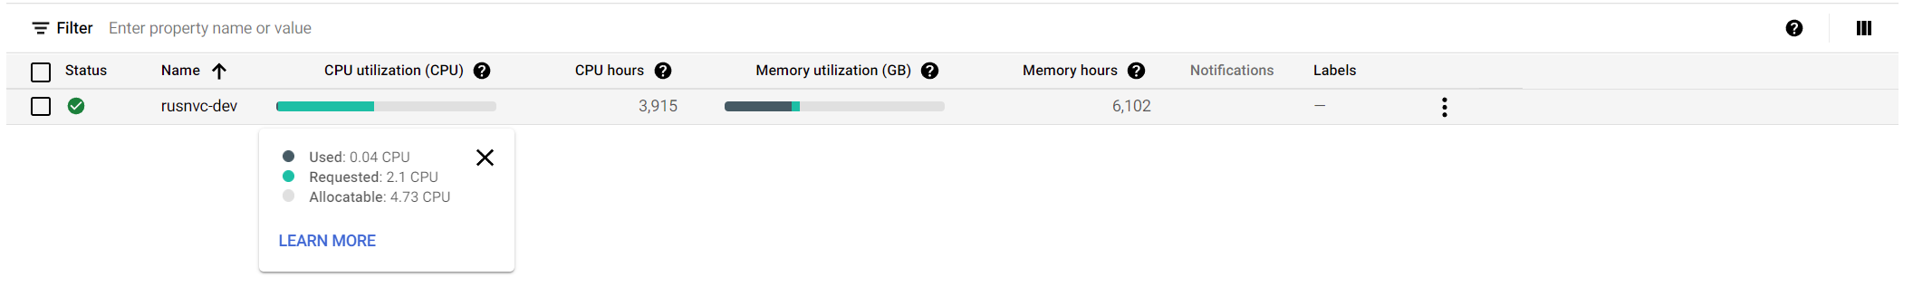
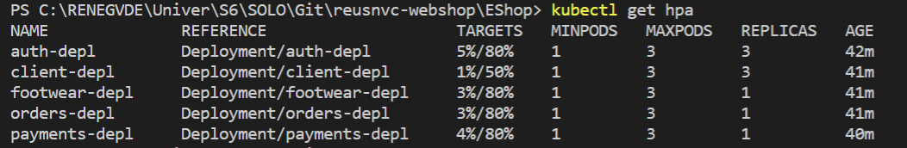
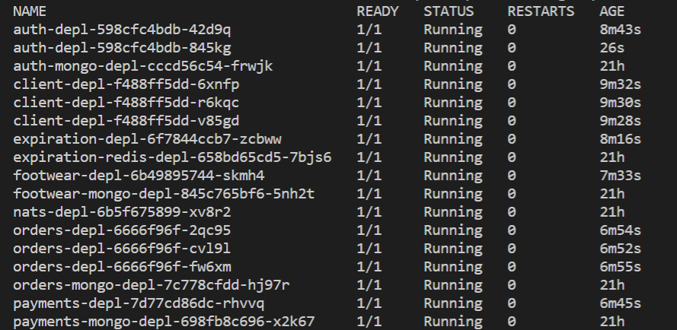
Scalability & Performance: Horizontal & Vertical Autoscale

Slide 5
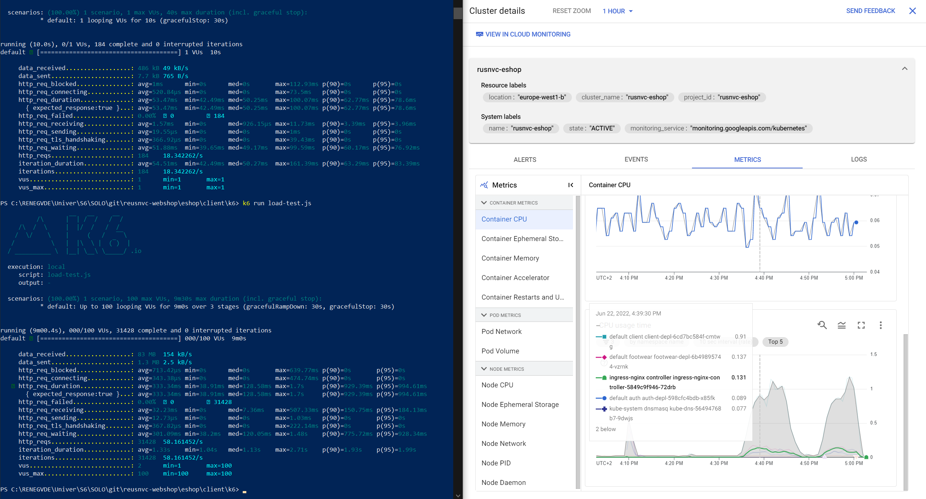
Scalability & Performance: k6 Performance

Slide 6
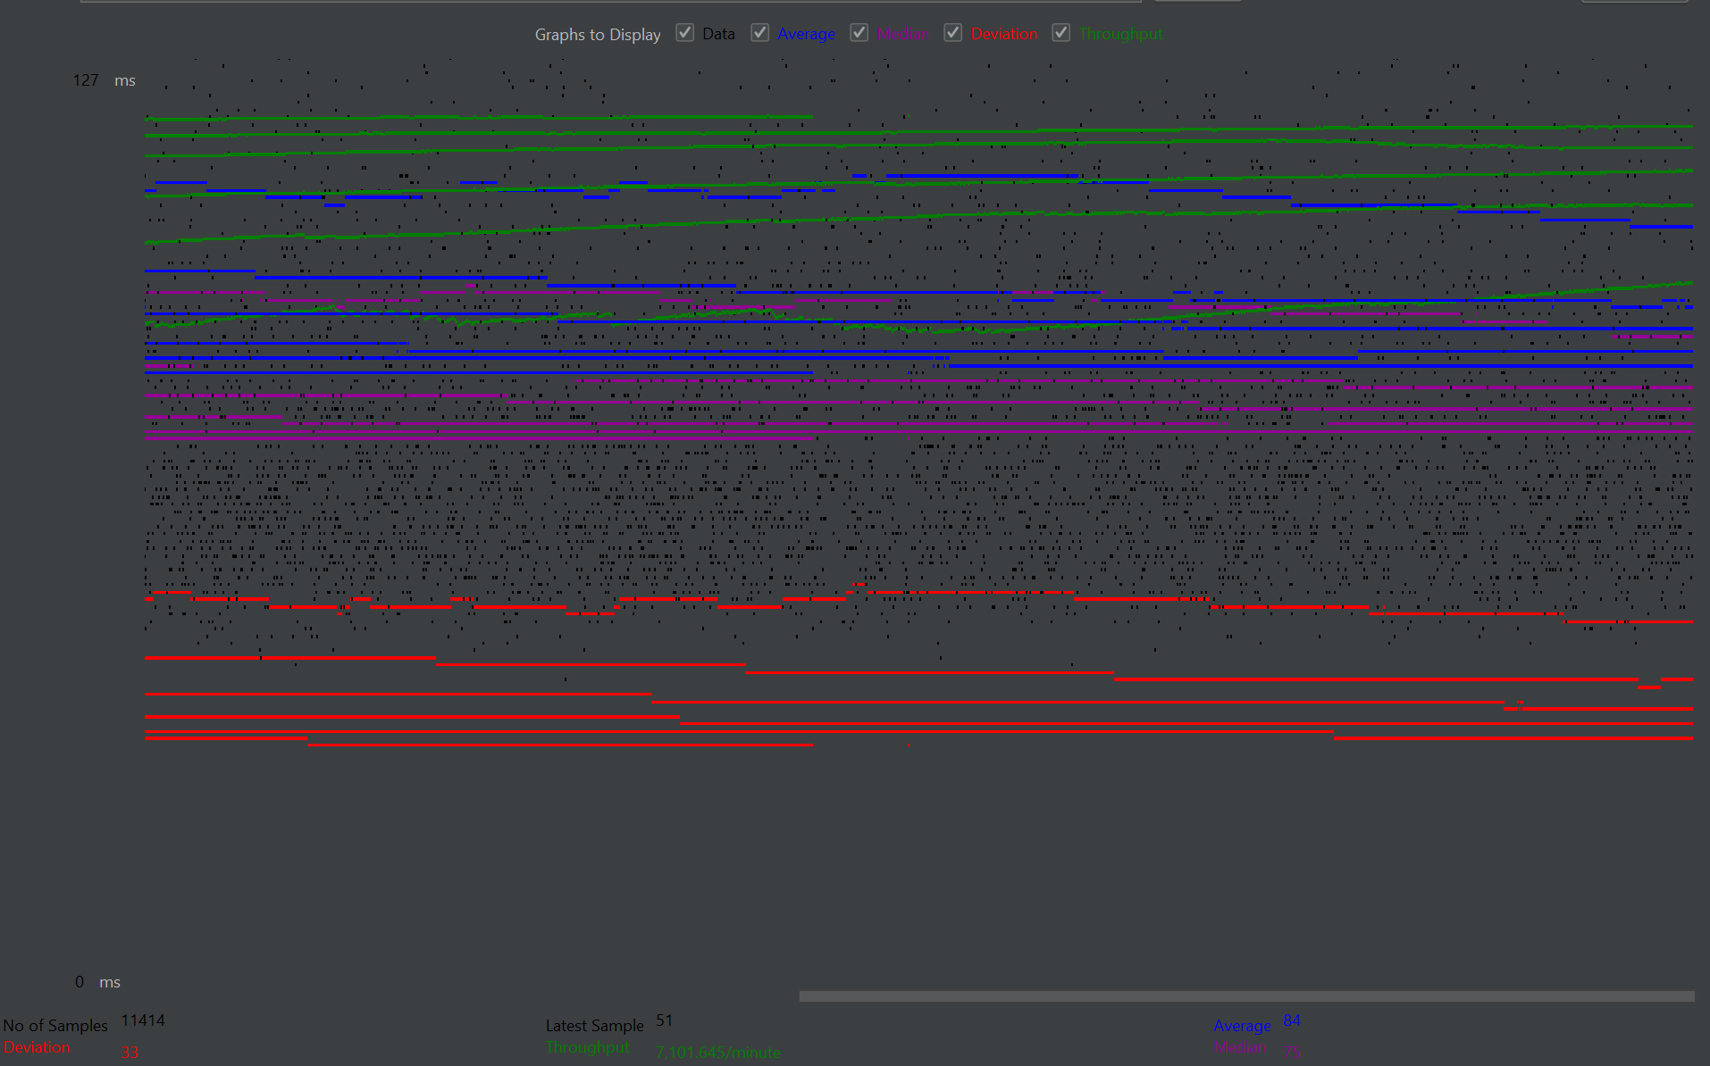
Scalability & Performance: Jmeter Performance
Average Response Duration: 84 ms
Throughput: 7,101/min

Slide 7
Estimated Load & Real Performance (StockX based)
StockX Traffic & Engagement per Month:
Total Visits : ~30 million
Avg Visit Duration: ~00:03:29
Interactions per Visit: ~4.43
StockX estimated requests per minute: 3425
System Real Performance:
Total Visits : ~61 million
Possible requests per minute: >7000
Estimated users/month | Estimated interactions / visit | Estimated requests/minute | Possible users/month | Possible requests/minute
~30,000,000 users/month | ~4.43 | ~3425 | ~61,000,000 users/month | >7000 requests/minute

Slide 8



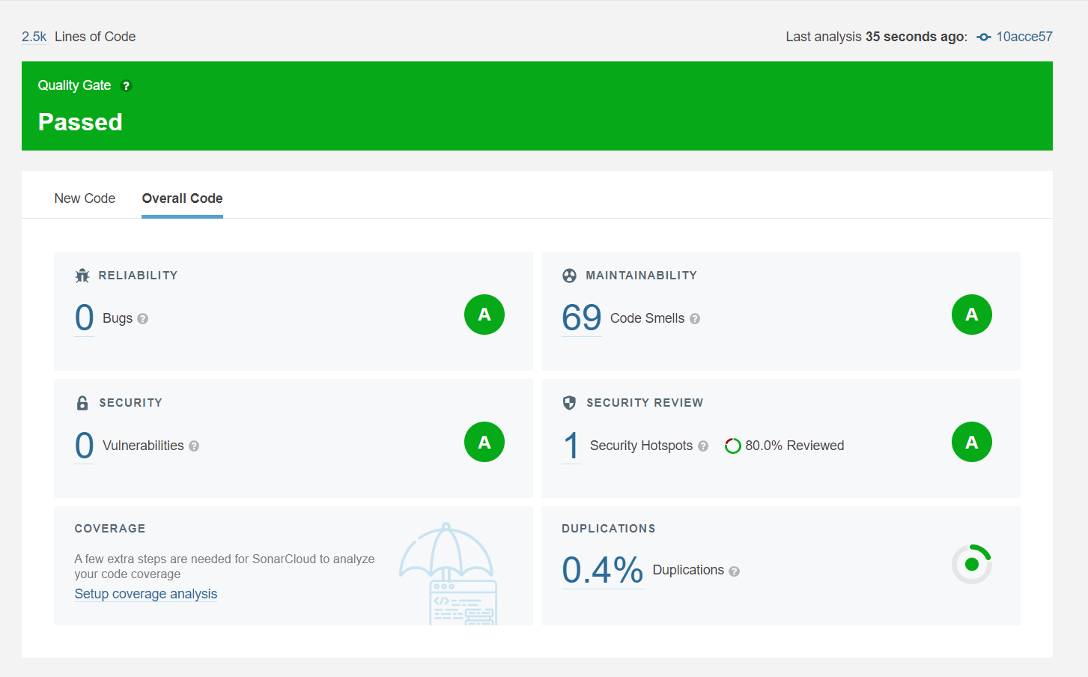

DevOps, CI/CD
SonarCloud:
At each push SonarCloud analyses Reliability, Maintainability and Security of the code.
CD:
If a modification to any service was made it will be automatically redeployed.
Unitests:
Prior to deployment unitests run for each service individualy.
Integration tests:
End to end testing is implemented using Cypress, a recording of it can be found in the Documentation folder, integrated in pipeline.
Performance test tests:
Performance testing is implemented using k6, through Client and directly to the API, integrated in pipeline.

Slide 9
Cloud Service
Used:
Cloud Storage – Store the k8s Cluster
Cloud Build – Used for deployment
Kubernetes Engine – Maintains the k8s cluster and handles the ‘health’
Autoscaler – Horizontal & Vertical Scaling
Load Balancig – Ingress NGINX Controller and Load Balancer
Cloud DNS – Domain setup
IAM – Provides Access to GKE k8s for CI/CD
Potential Use:
Payment Service – Used instead of Stripe for payment
Filestore – Used to store footwear images
MongoDB Atlas – Replacement for DB inside the cluster
Certification – Used for SSL & TLS

Slide 10
DEMO

Slide 11
Questions & Discussion

